Slide 1
Open house
Welcome to 1st Grade!
Mrs. Christina Smith

Slide 2
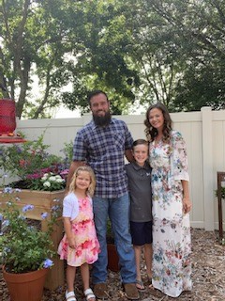
Personal Info
I graduated from the University of North Florida with a BA in Special Education and Elementary Education.
I have taught high school in public school and elementary in private school.
I love being able to share the Word with our students and teaching them about Jesus.
My husband, Aaron, and I have been married for 11 years. We have a son named Easton who is 9 years old and a daughter named Annabelle who is almost 6 years old.
Our family loves camping, paddle boarding, biking and anything that is an outdoor adventure!

Slide 3
Homework
Homework is assigned on a weekly basis and is graded.
On Monday, your child’s yellow homework folder will come home with the week’s packet as well as a leveled book to practice reading.
Your child will take an AR (Accelerated Reader) Comprehension quiz on this book on Friday.
Included in the homework packet are our goals and study focus for the week.
The homework and book are due back on Friday.

Slide 4
Student Folders
Blue Folder
On Tuesdays, your child’s blue folder will come home with the previous week’s work and any office correspondence. Please sign off on the stapled review sheet and look through your child’s assignments with them. They have been working very hard and have a lot to share!
Please return any papers asking for a parent signature.
Tuesday folders are to be returned on Wednesday.
Red Folder
Communication will be sent home daily with any school or class correspondence within the red folder.
Please return to school daily.

Slide 5
Tests and Quizzes
Weekly tests are on Fridays:
Spelling
Comprehension
Phonics
Bible verse
Bible Lesson Test
Vocabulary
Chapter tests for other subjects are posted several days prior to the test. Check Monday’s Newsletter under tests for dates and study information.
It’s up to you how far you’ll go.
If you don’t try, you’ll never know.

Slide 6
Grading
Bible:
Bible Verse 40%
Bible Test 30%
Classwork 30%
Math:
Classwork 40%
Assessment 30%
Fluency 30%
Science/Social Studies:
Classwork 45%
STEM 20%
Test 35%
Reading:
Classwork 30%
Comprehension/AR 30%
Fluency 10%
Vocabulary 30%
Writing:
Planning 30%
Draft 30%
Final 40%
Spelling:
Classwork 30%
Spelling Assessment 35%
Phonics Assessment 35%
English:
Classwork 50%
Assessment 50%
Penmanship:
Handwriting 100%
Study Skills:
Homework 100%
Conduct:
Conduct 100%

Slide 7
Resource Schedule
Monday
Spanish 12:10-12:50
Library 1:25-2:05
Tuesday
P.E. 8:55-9:40
Wednesday
Computer 1:00-1:50
Thursday
Chapel 8:20-8:50
Friday
Music 8:10-8:50
STEM 2:30-3:00
Art Classes will begin during the 2nd Semester

Slide 8
Technology
We will be utilizing IXL, Think Central, AR/Renaissance, Savvas Realize, HMH Math
Grades will be posted in a timely manner on Renweb/FACTS

Slide 9
Curriculum
Journeys - Reading and Spelling (Think Central)
Shurley English - English
HMH Into Math
Savvas Realize - Science
Scholastic - Social Studies
ACSI Purposeful Design - Bible

Slide 10
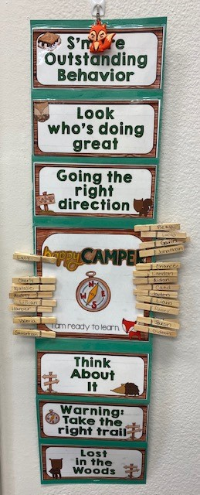
Classroom Management System
We utilize a Clip Chart System in first grade. Students begin each day on “Happy Camper” and have the opportunity to move up to earn Treasure Box on Fridays. For students who reach “S’more Outstanding Behavior”, a keychain is earned. For “Lost In the Woods”, parent contact is required.

Slide 11
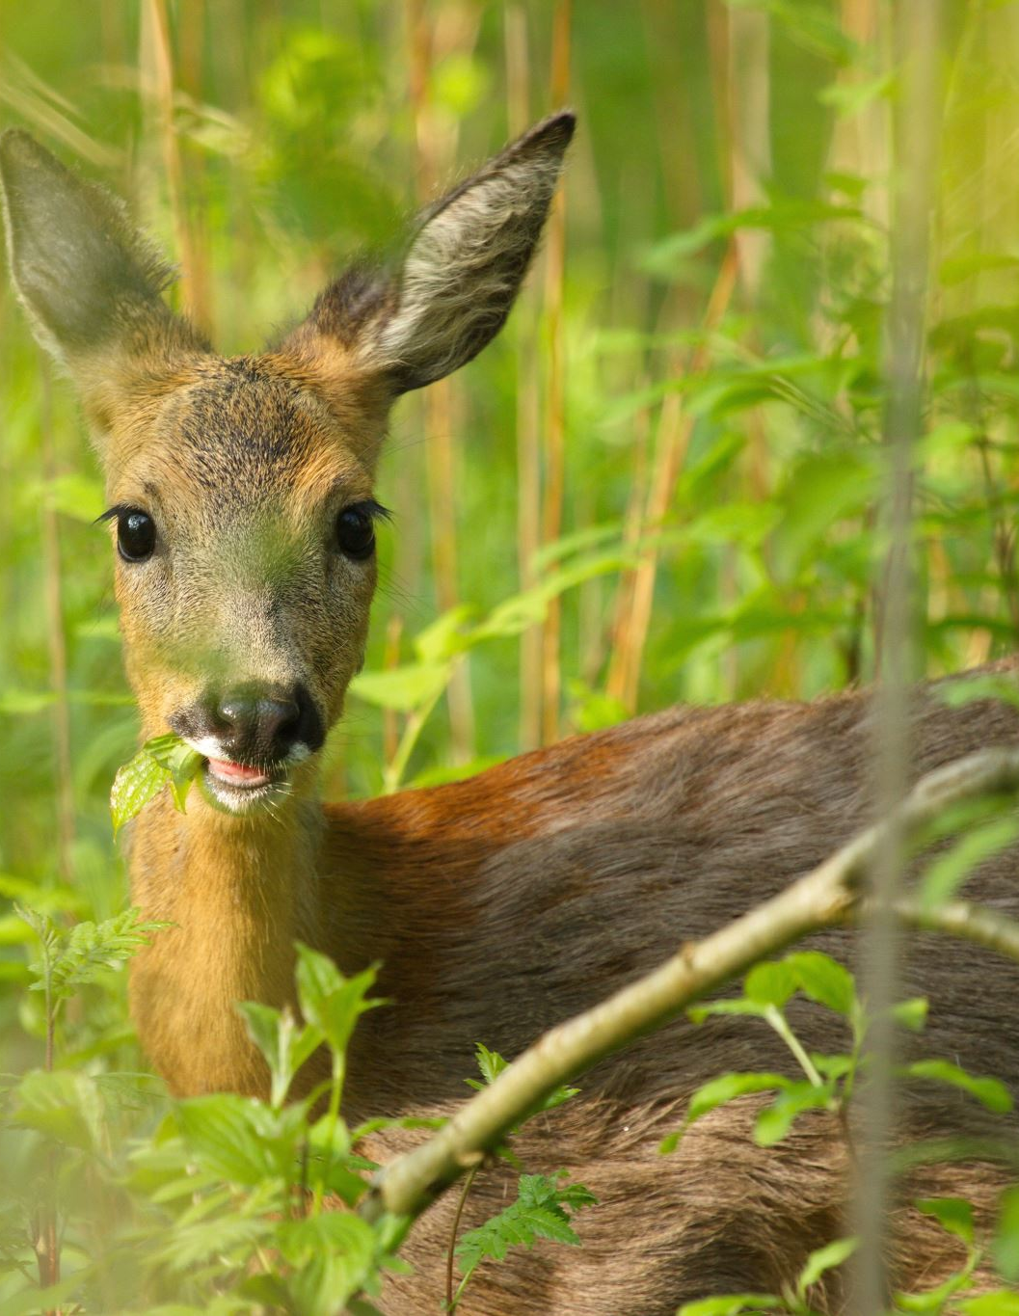
How You CAN HELP OUR CLASS
Treasure Box Items
(no candy please)
Snack Donations
Continued prayer
Stock the School (ccajax.org for details)

Slide 12
Fieldtrips
We are having field trips this year but do not have any scheduled at this time.
Updates will be coming soon!

Slide 13
CommunicationQuestions and Concerns
Email: Csmith@ccajax.org
Leave a message with Mrs. Feltman at the Welcome Center and she will route it to me.
Send in a note with your student in the RED Communication Folder.

Slide 14
Thank you for coming!
Thank you again for entrusting us with your children and we are looking forward to an amazing year in First Grade!

