Slide 1
AP Human Geography

Slide 2
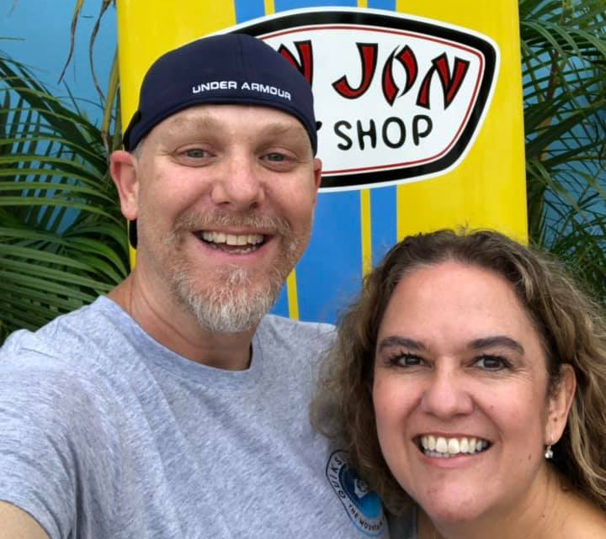
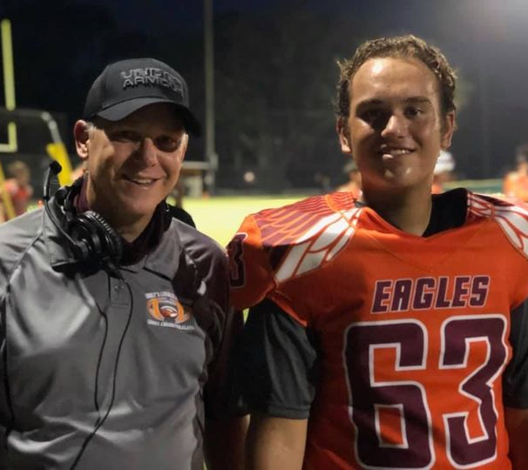
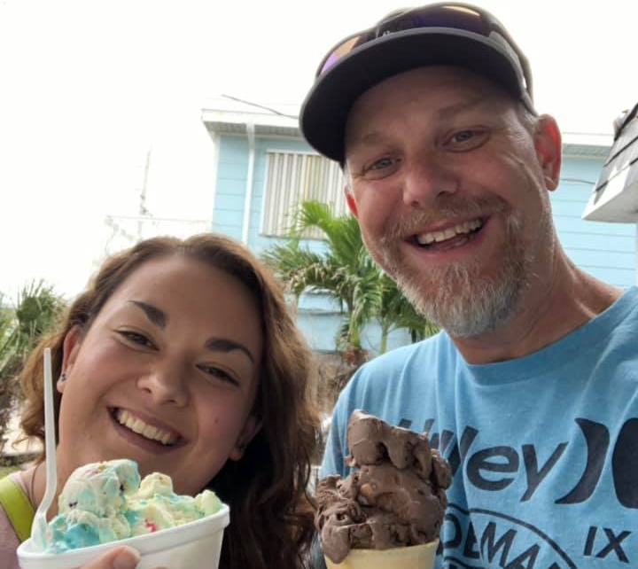
The Teacher: Coach Carter or Mr. Carter
Christian for 33 years, Husband to Christina for 25 years, Dad to Caitlyn (21) & Matthew (17)
Educator since 1999 at the middle, high school, & college levels.
Bachelor of Science in History (Eastern New Mexico University)
Master of Science in Recreation & Sport Science (Ohio University)
Football coach (15 years) at the middle and high school levels

Slide 3
Contact Info
Mr. Carter can be reached at the following email address:
ecarter@ccajax.org

Slide 4
The Course
From the AP College board description:
This course introduces students to the systematic study of patterns and processes that have shaped human understanding, use, and alteration of Earth’s surface. Student’s employ spatial concepts and landscape analysis to examine socioeconomic organization and its environmental consequences. They also learn about the methods and tools geographers use in their research and applications.
The AP Human Geography course is equivalent to an introductory college-level course in human geography

Slide 5
Materials
TEXTBOOK:
Human Geography for the AP Course; Hildebrandt, et. al New York, N.Y.: Bedford, Freeman & Worth
OTHER:
Laptop or tablet for in class assignments, research, & projects
Spiral notebook for completing bell work assignments, exit tickets, and taking notes in class
Mechanical pencil, or ink pen

Slide 6
Assignments & Grading
Assignments will include:
Bell work
Reading quizzes
Reading questions
Chapter & unit tests
Projects
Presentations
Exit tickets
Notes & notebook checks
Assignments will be pulled from a variety of sources and not necessarily exclusively from the textbook
Homework assignments will be posted in the homework notes section of FACTS.

Slide 7
Assignments & Grading Cont.
Assignments will be graded based on the standard grading scale of 90 to 100 is an A, 80 to 89 is a B, etc.
Grading typically takes place over the weekend and grades are updated by the end of the day each Monday
Assignments should be turned in on time. The class will adhere to the CCA late work and make up work policies (see handbook)
No extra credit assignments will be given.

Slide 8
What you can expect from Mr. Carter
Students and parents can expect me to:
Be approachable
Be fair
Respect their time
Provide a safe learning environment
Communicate in a timely manner
Listen
Pray for them & with them
Be professional

Slide 9
Expectations of Students/Parents
Students—I will expect students to:
Be on time
Come to class prepared (all supplies & ready to work)
Be considerate of others (both classmates & their teacher)
Communicate in a timely manner
Put forth their best effort
Parents—I would ask parents to:
Be supportive
Be considerate
Communicate any issues in a timely manner

