Slide 1
BIBLE CLASS

Slide 2
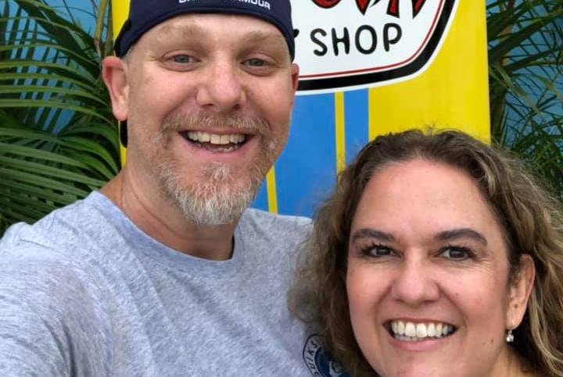
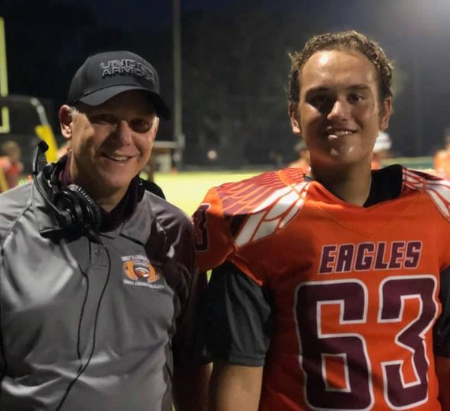
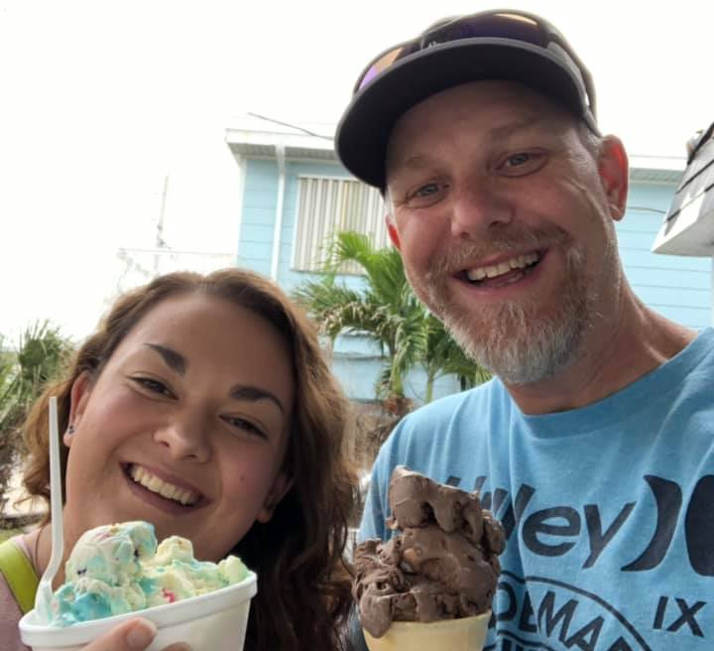
The Teacher: Coach Carter or Mr. Carter
Christian for 33 years, Husband to Christina for 25 years, Dad to Caitlyn (21) & Matthew (17)
Educator since 1999 at the middle, high school, & college levels.
Bachelor of Science in History (Eastern New Mexico University)
Master of Science in Recreation & Sport Science (Ohio University)
Football coach (15 years) at the middle and high school levels

Slide 3
Contact Info
Mr. Carter can be reached at the following email address:
ecarter@ccajax.org

Slide 4
The Course
A developmental class designed to help students grow in their spiritual life
Course content will include:
Christian worldview, Bible reading & study, Christian reading, topical discussions, and community service.
Students are asked to treat the material seriously and “be real” as course content is examined and discussed.

Slide 5
Materials
a Bible (English Standard or ESV), a composition notebook, pen or pencil, a highlighter, and any provided materials. These materials should be in class with the student every day.
NOTE: Periodic checks for materials will be made, and homework or quiz grades will be given for possessing proper materials.

Slide 6
Assignments & Grading
Assignments will include:
Journal Prompts Journal Responses
Memory Verses Bible Readings
Projects Christian Readings
Class Discussions
Homework assignments will be posted in the homework notes section of FACTS.

Slide 7
Assignments & Grading Cont.
Assignments will be graded based on the standard grading scale of 90 to 100 is an A, 80 to 89 is a B, etc.
Grading typically takes place over the weekend and grades are updated as soon after grading as possible.
Assignments should be turned in on time. The class will adhere to the CCA late work and make up work policies (see handbook)
No extra credit assignments will be given.

Slide 8
What you can expect from Mr. Carter
Students and parents can expect me to:
Be approachable
Be fair
Respect their time
Provide a safe learning environment
Communicate in a timely manner
Listen
Pray for them & with them
Be professional

Slide 9
Expectations of Students/Parents
Students—I will expect students to:
Be on time
Come to class prepared (all supplies & ready to work)
Be considerate of others (both classmates & their teacher)
Communicate in a timely manner
Put forth their best effort
Parents—I would ask parents to:
Be supportive
Be considerate
Communicate any issues in a timely manner

