Slide 1
Sculpture I
Alycia Phoenix Daniels
adaniels@ccajax.org

Slide 2
Education /Experience
Graduate of James Madison University
Bachelor of Science in Art, Minor Education, Minor in Art History
Been an art teacher since 2004
Taught in both private and public schools and taught every grade level
Currently teach Drawing I, Drawing II, Painting I, Painting II, Sculpture I, Sculpture II, Ceramics I, Ceramics II, Honors Portfolio Development
Member NAEA, FAEA, ACSI certified, National Art Honor Faculty Sponsor

Slide 3
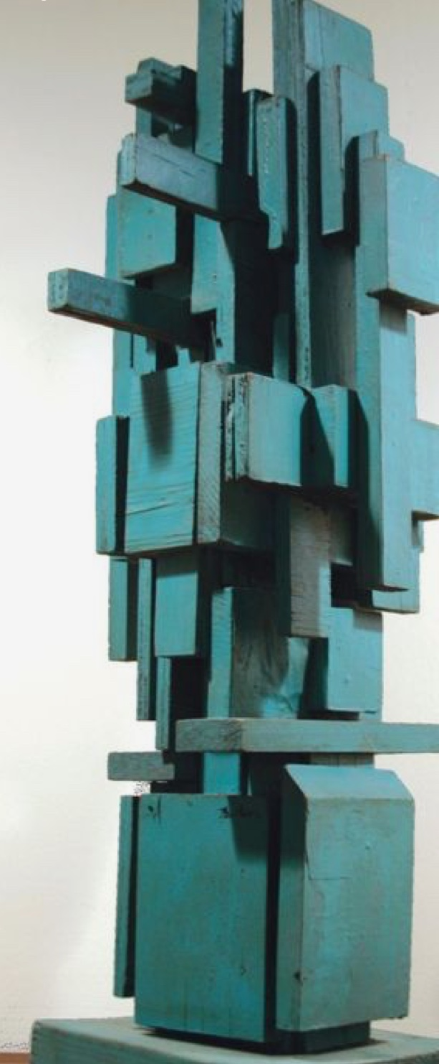
Sculpture I
This course focuses on the Elements of Art and Principles of Design in 2D and 3D works of art. Students will be exposed to a variety of mediums such as: plaster, mosaics, metal tooling, paper mache, etc. Students will learn Art History and “art in the real world” through art related careers.
1 Semester $60 Art Fee

Slide 4
Examples of Student Work:

Slide 5
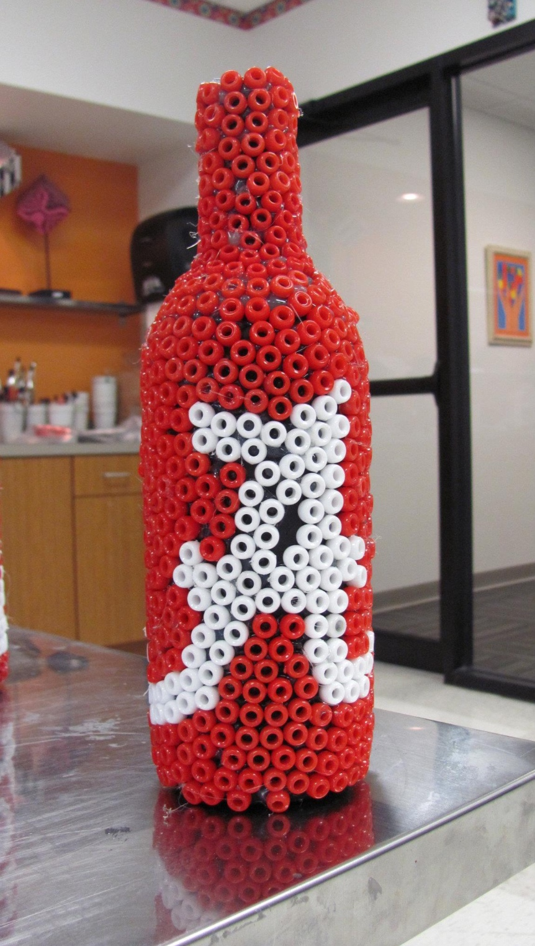
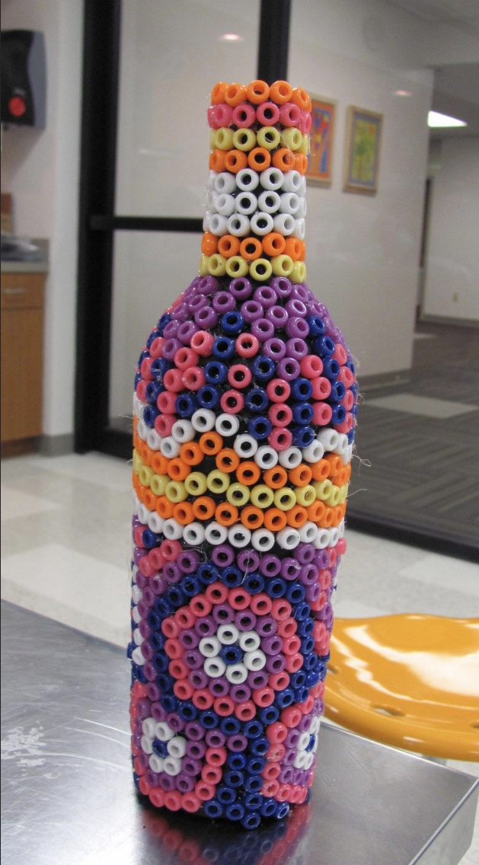
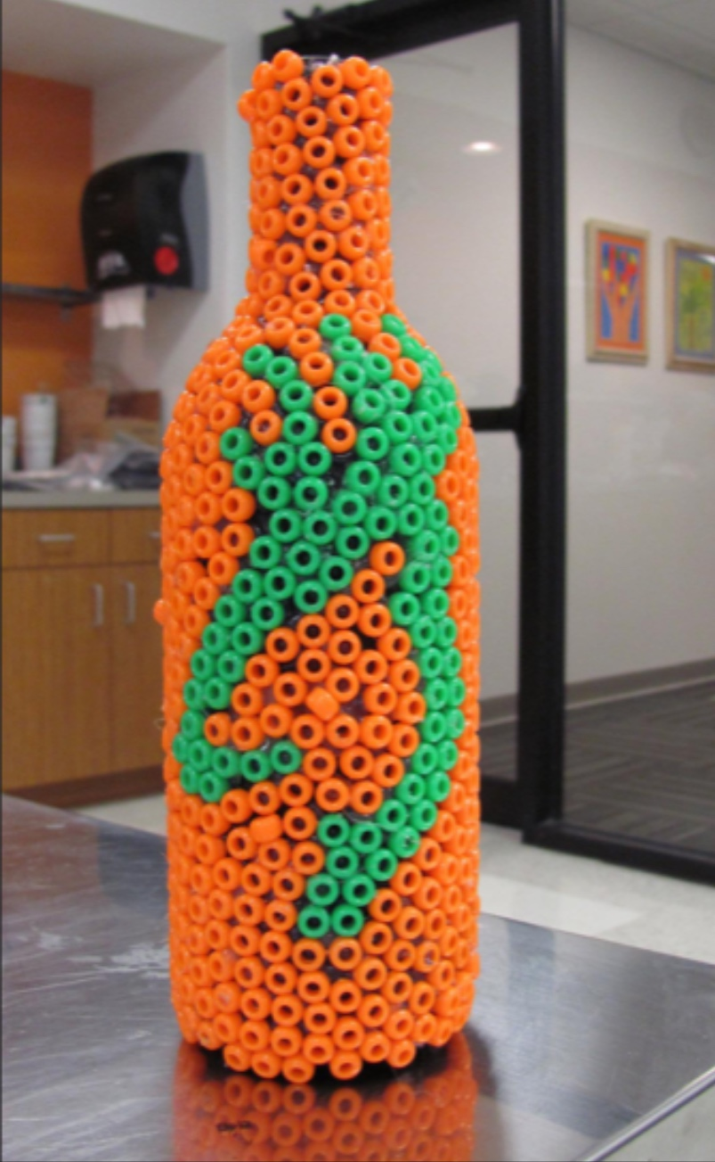
Beaded Bottles
Inspired by the Huichol Indian Tribe

Slide 6
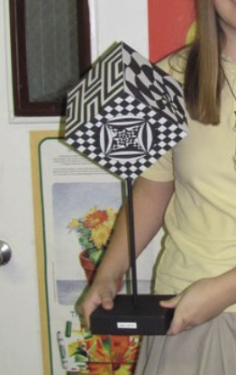
Optical Illusions

Slide 7
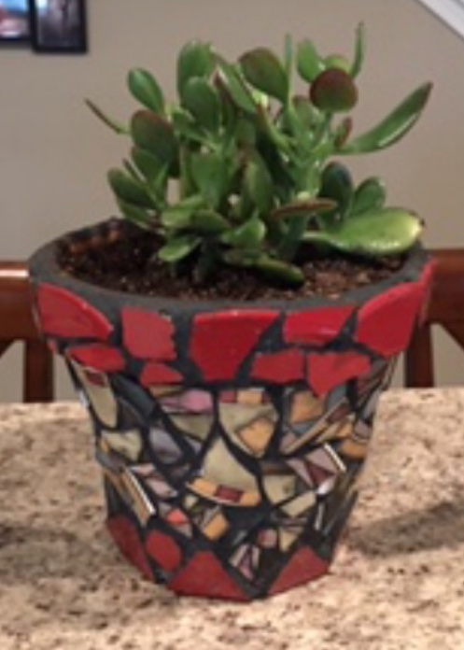
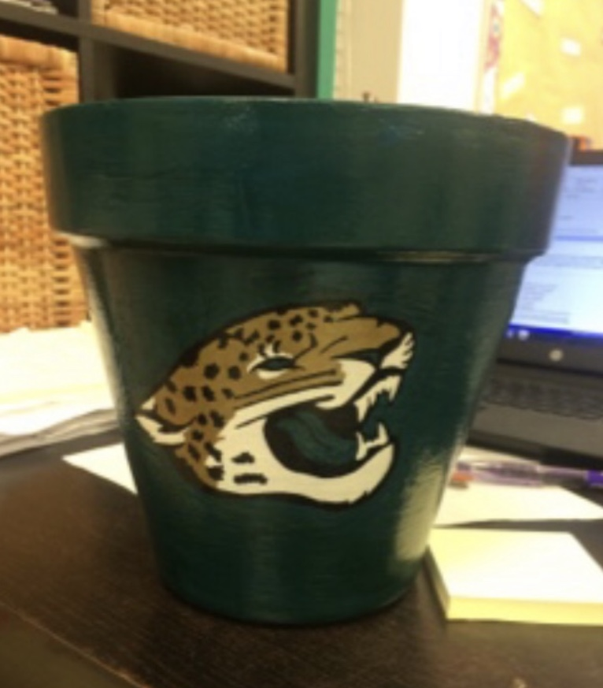
Decorative Planters

Slide 8
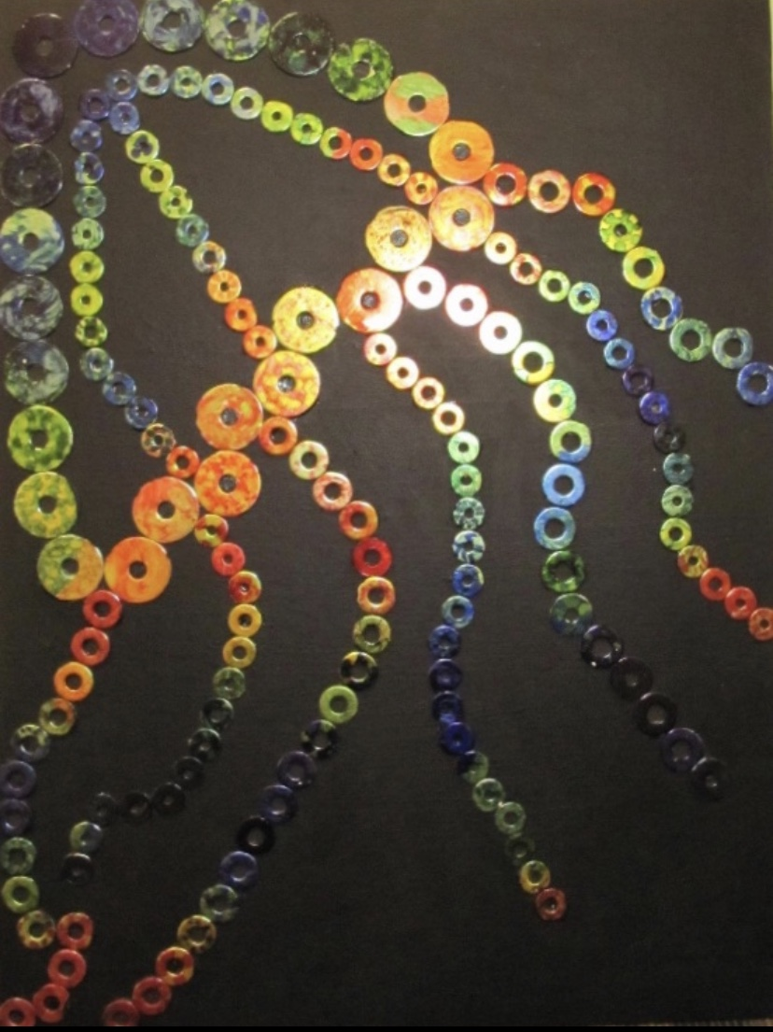
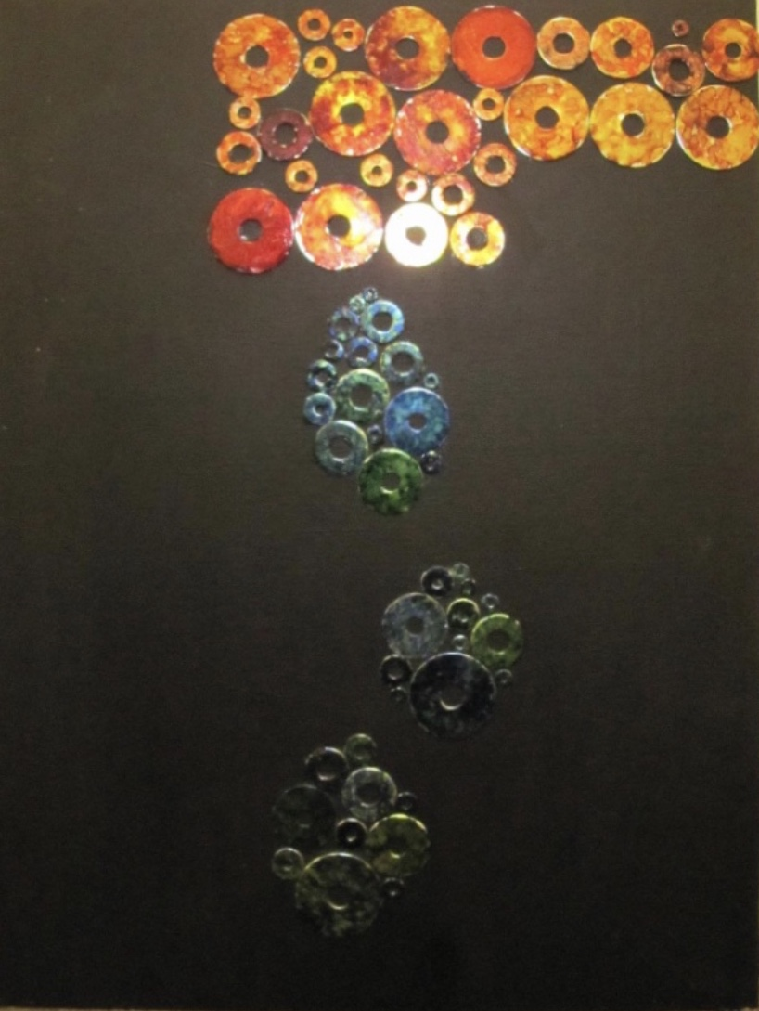
Ink Dyed Washers

Slide 9
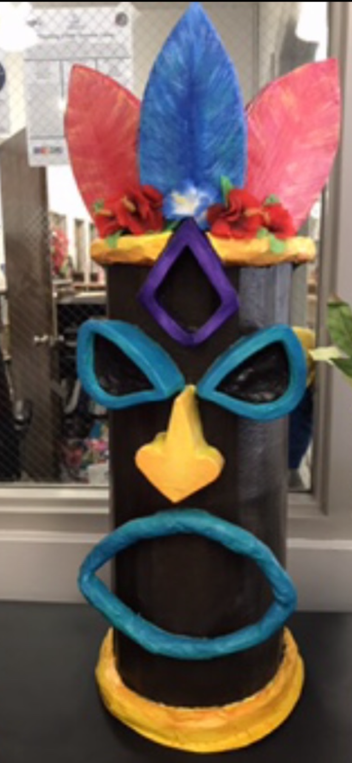
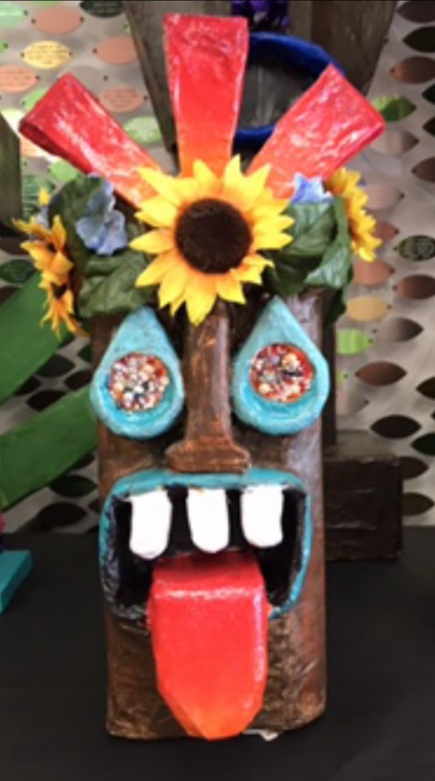
Paper Mache Tikis

Slide 10
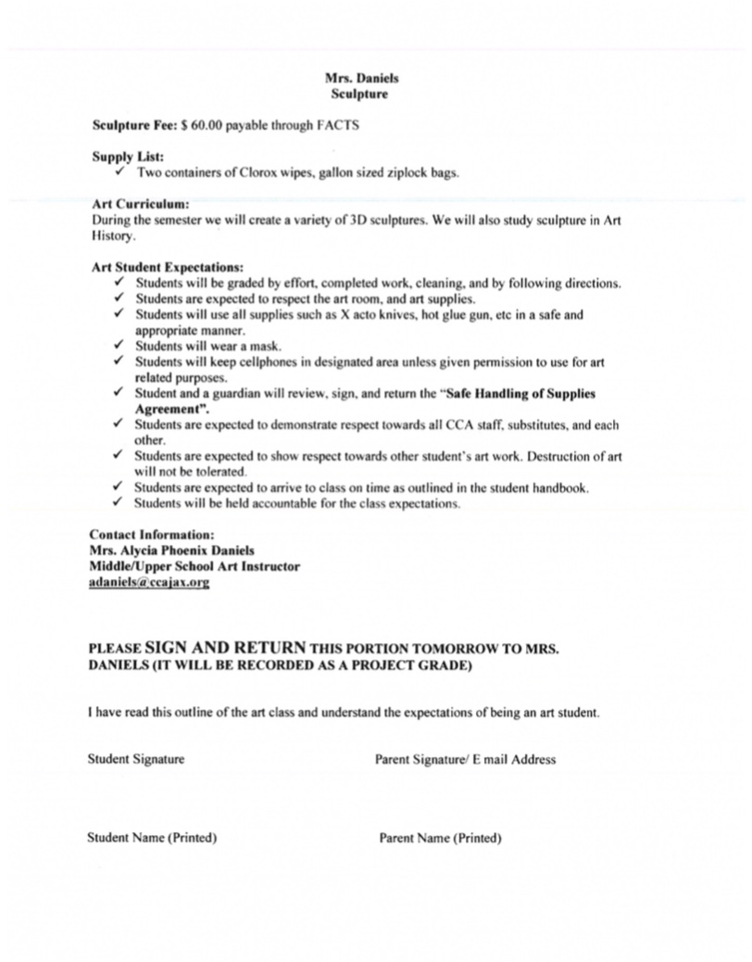
Class Syllabus

Slide 11
Grading Percentages
20% Cleaning. (weekly grade).
20% Participation. Working daily, contributing to class discussions (weekly grade).
60% Projects. Following directions, completion, turning work in.

Slide 12
Contact Information:
adaniels@ccajax.org
Thank you for your support of the Art Department at CCA!

