Slide 1
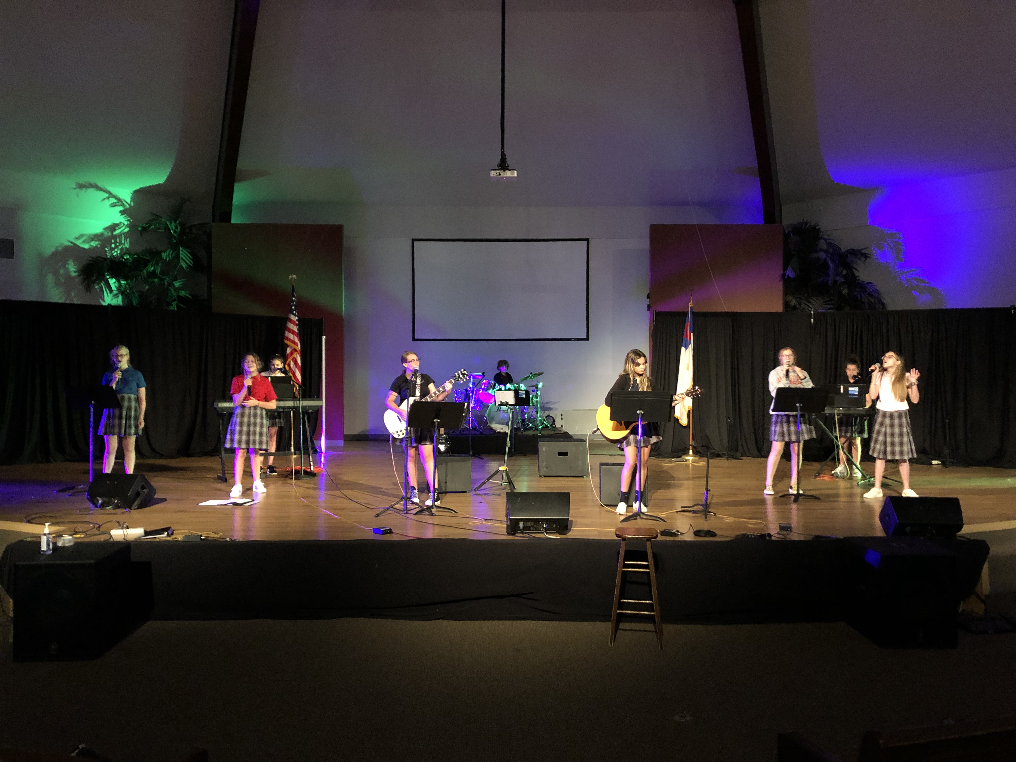
M
S
W
O
R
S
H
I
P
Notes:
ZPeriod Worship

Slide 2
Marianne Vargas
Fine Arts Department Lead Teacher
Bachelor of Music Education from Jacksonville University
Tri-M National Music Honor Society Sponsor
Orff Teaching Methods Certification
28 years teaching experience
20 years church worship
16th year at CCA
Subjects Taught - Orff Mallet Ensemble, MS Worship, ZPeriod Worship, Drama, Chorus

Slide 3
MS Worship 2:20-3:10 p.m.
Middle School Worship Class Syllabus
The purpose of this course allows students to become leaders of worship through music and technology. The course emphasizes that worship begins in our hearts by having a relationship with Christ. Worship is our response to who God is and the revelation of what He has done for us. It also enables students to develop musical and technological skills in a small ensemble setting through the study of varied worship literature. Emphasis will be placed on leadership, vocal and instrumental independence, expressiveness and stylistic authenticity. Students will develop technology skills through the use of audio/visual equipment.

Slide 4
Assessments
Participation in rehearsals/chapel
Keyboard and Guitar skills
Activities – Worship opportunities inside/outside of school,
Class worship studies
Grading
Classwork 60%
Test and Bible Study 30%
Notebook Check 10%

Slide 5
Events
Weekly Chapels (Thursdays @ 8:55 a.m.
All School Christmas Program at Christ’s Church – 12/6/21
Night of Worship – TBD (Spring)
Any invites from churches or other events
Performing Arts Trip - TBD

Slide 6
Behavior
As a Christian, you are called to a higher standard. Christians are called to be set apart from the world and set an example so that others might see Jesus’ love through them. As a MS worship participant, you are a visible role model. Please pray about and take this statement to heart. The expectation, related to your behavior both in and outside of the classroom, is that you will strive to live your life as an example to God and others.
¹⁴ “You are the light of the world. A town built on a hill cannot be hidden. ¹⁵ Neither do people light a lamp and put it under a bowl. Instead, they put it on its stand, and it gives light to everyone in the house. ¹⁶ In the same way, let your light shine before others, that they may see your good deeds and glorify your Father in heaven. Matt: 5:14-16

