Slide 1
7th grade World Geography
Mrs. Owens| 1st and 5th period
eowens@ccajax.org

Slide 2
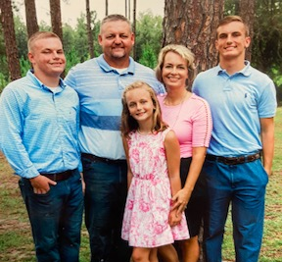
Erin Owens
6th year here at CCA
12th year teaching—a little break in between to be a stay-at-home mom
Wife and mom of 3
Love being apart of the CCA family
Here to help and support!
Notes:
Insert a map of your country.

Slide 3
Middle school goals
Spiritual and Academic Growth
Establish System of Organization
Build Responsibility ( interacting with teachers to solve problems encountered)
Time Management- Students learning to study nightly before a test, or quiz.
Compare our studies with God’s Word

Slide 4
Materials needed for class
Binder with Dividers
IPAD or DEVICE—a MUST…since all our material is online.
Journal/Paper for essays and some maps
Pen or pencil to write with and colored pencils for maps.

Slide 5
Curriculum:
We have an exciting Social Studies Curriculum for 6-8th grades.
Geography Alive!… published by Teachers Curriculum Institute (TCI)
Web Based- To access go to Teachtci.com for Student Text
Students have their own account (username and password).
This program is interactive with emphasis on collaboration and cooperative activities.

Slide 6
Grading percentages:
Tests (maps and content): 30%
Quizzes(and projects): 40%
Homework / Classwork: 30%

Slide 7
Late work policy:
Late Work Policy:
1 day late = student will earn 75% of graded work (25% reduction)
2 days late= student will earn 50% of graded work (50% reduction)
No credit is given for work submitted three or more school days late.
When an assignment is missing, it will show as a M in the gradebook, and should be calculated in as a zero.
Absences: It will be the student’s responsibility to find out the assignment and lessons they have missed.

Slide 8
Questions, Concerns, Prayer Requests please contact me at: eowens@ccajax.org
Looking forward to a great year!!!

