Slide 1
Weightlifting
7th period
Coach owens

Slide 2
Erin Owens
6th year here at CCA
12th year teaching—a little break in between to be a stay-at-home mom
Wife and mom of 3
Love being apart of the CCA family- a calling!
Here to help and support!
Bachelor of Science- Physical and Health Education K-12

Slide 3
Purpose:
This course is designed to give students the opportunity to learn weight training/lifting concepts and techniques used for obtaining optimal physical fitness, while learning God’s principles for healthy living.

Slide 4
Expectations
Students will lift 4 days a week
1 day for fitness and team building.
Students are expected to display Christ-like conduct. This includes having a good attitude, treating others with respect, and following class and school rules.

Slide 5
Materials
• CCA P.E. uniform
• Water bottle
• Good attitude

Slide 6
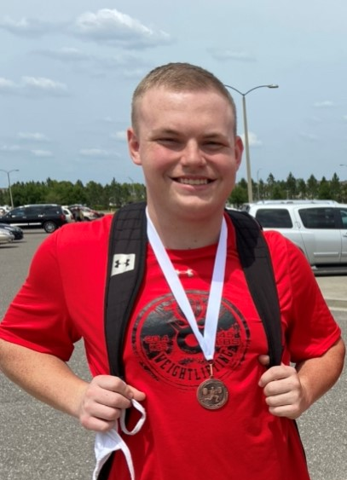
Grading
50%- Dressing out
50%- Participation
Grades taken daily, entered weekly

Slide 7
Absences
•If a student has more than 10 excused absences, there may be written assignments to complete
•It will be the student’s responsibility to communicate with the teacher upon returning to school
•Please refer the CCA handbook regarding absences

Slide 8
Contact Info.
Please contact me at: eowens@ccajax.org
Questions, Concerns, Prayer Requests

