Slide 1
Computer Science & Discoveries
Welcome to

Slide 2
Introduction of Technology Instructor
Name: Scott Vail
Have been teaching since 2021
Technology Professional for over 15 years
Education: BA in Mgmt Information Systems from FAU
BS in Marketing from FAU
CompTIA Network + certified
Microsoft Certified Professional
Hobbies: Black Belt in Kenpo Karate, Anything relating to Star Wars or Marvel,
God, Family, and Friends, Yes, in that order.

Slide 3
Computer Science is Based On The Following:
Coding with Code.Org
Coding with Scratch

Slide 4
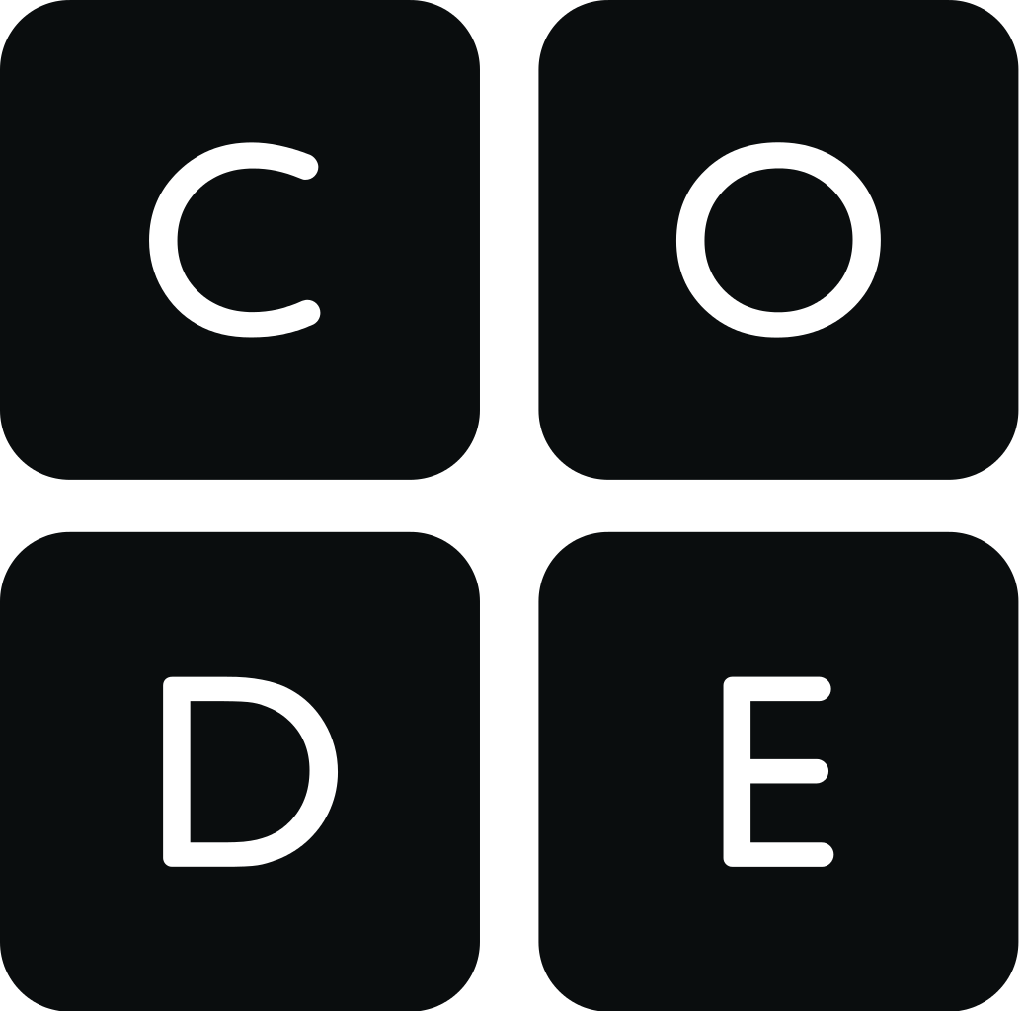
Code.Org Skills Are Taught From 6 Separate Units:
Unit 1 is a highly interactive and collaborative introduction to the field of computer science, as framed within the broader pursuit of solving problems. You’ll practice using a problem solving process to address a series of puzzles, challenges, and real world scenarios. Next, you’ll learn how computers input, output, store, and process information to help humans solve problems. The unit conclude with a project in which you design an application that helps solve a problem of your choosing.
In Unit 2, students are empowered to create and share the content on their own web pages. They begin by thinking about the role of the web, and how it can be used as a medium for creative expression. As students develop their pages and begin to see themselves as programmers, they are encouraged think critically about the impact of sharing information online and how to be more critical content consumers. They are also introduced to problem solving as it relates to programming, as they learn valuable skills such as debugging, commenting, and structure of language. At the conclusion of the unit, students compile their work to create a personal website they can publish and share.
In Unit 3, you’ll build on your coding experience as you program animations, interactive art, and games in Game Lab. The unit starts off with simple shapes and builds up to more sophisticated sprite-based games, using the same programming concepts and the design process computer scientists use daily. In the final project, you’ll develop a personalized, interactive program.

Slide 5
Code.Org Skills Are Learned From 6 Separate Units: (cont)
Unit 4 introduces the broader social impacts of computing. Through a series of design challenges, you will learn how to better understand the needs of others while developing a solution to a problem. The second half of the unit consists of an iterative team project, during which teams have the opportunity to identify a need that they care about, prototype solutions both on paper and in App Lab, and test solutions with real users to get feedback and drive further iteration.
Unit 5 is about the importance of data in solving problems and highlights how computers can help in this process. The first chapter explores different systems used to represent information in a computer and the challenges and tradeoffs posed by using them. In the second chapter, you’ll learn how collections of data are used to solve problems, and how computers help to automate the steps of this process. The chapter concludes by considering how the data problem solving process can be applied to an area of your choosing.
Unit 6 explores the role of hardware platforms in computing and how different sensors can provide more effective input and output than the traditional keyboard, mouse, and monitor. Using App Lab and Adafruit’s Circuit Playground, you’ll develop programs that utilize the same hardware inputs and outputs that you see in the smart devices, looking at how a simple rough prototype can lead to a finished product. The unit concludes with a design challenge to use the Circuit Playground as the basis for an innovation of your own design.

Slide 6
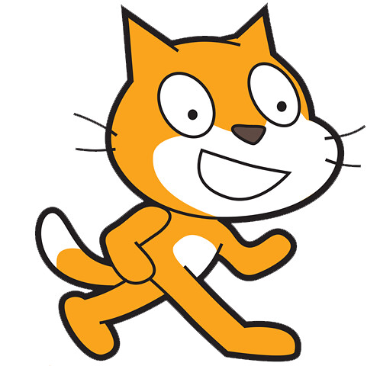
Scratch Programming Skills
reasoning logically,
debugging problems, within the code
developing ideas from initial conception to completed project,
sustaining focus.
They can also learn specific programming concepts, such as
sequences,
Iteration,
conditionals,
variables,
data structures.

Slide 7
Computer Science and Discoveries
Computer Science Discoveries (CS Discoveries) is an introductory computer science course that empowers students to create authentic artifacts and engage with computer science as a medium for creativity, communication, problem solving, and fun.

